Slide 1



Decentralized Social Network using Blockchain (Dinke-Din)
Supervised By
Mohammad Sazid Zaman Khan
Lecturer
Department of CSE, IIUC
Presented By
Jamshedul Alam - C171029
Mohammed Raihan - C163069

Slide 2
Background
The New York Times reported in March 2018 that a business fraudulently got information from more than 50 million Facebook users .
In the last decade, dozens of media companies, ranging from prestigious publications like the Washington Post to social media platforms like Facebook, have seen customers’ and the companies’ private data exposed.

Slide 3
Blockchain Decentralized Website
Brave browser enable decentralized web.
Patient Centric Image Management.
Tweetchain
Traffic Police Assistant system.
Secure Research record keeping.
HealthSense

Slide 4
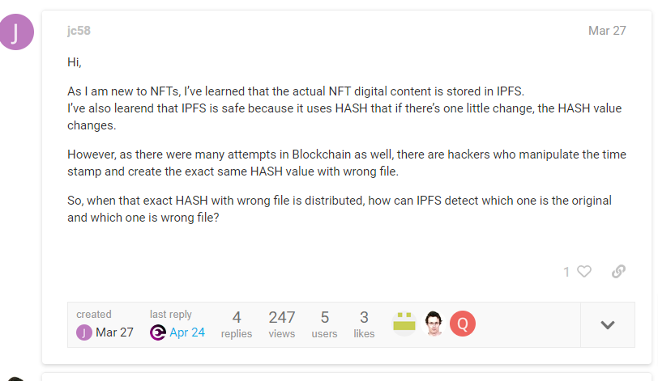
Problem Statement

Slide 5
HTTP request would look like this
http://10.20.30.40/user/post/image
IPFS request would look like
https://ipfs.io/ipfs/Qmbev52icDQtBMozC7pbuqxKEtPvnw3473EGkuDfhXeGLw?filename=Image%201.png

Slide 6
Literature Review
SL No. | Name | Descriptions | Limitations
3 | IdM system | based on Single Sign-On services . SP validates the identity and credentials with an Idp , preventing the user needs to enter it’s identifier and password to access the services.. | It left authentication layer risky.

Slide 7
SL No. | Name | Descriptions | Limitations
3 | Medical Image Sharing system | Blockchain based image sharing system . It also offers data encryption features. Since each transaction requires peer-to-peer verification. | It has no strong auhentication system .

Slide 8
SL No. | Name | Descriptions | Limitations
3 | Fast Image encryption system . | uses the permutation and diffusion to encrypt the image .they used permutation algorithms including sorting-based permutation algorithm .They emphaiss on using of parrallelism of diffusion to get quality full result on image encryption . | i .

Slide 9
Research Gap
Most of the applications have Complexity in using Image encryption and decentralization the system
They have limitations in combining authentication and Blockchain in same system
Most of the system are mainly focused on providing a secure system on their own system

Slide 10
Objectives
Protecting User Account
To keep personal data access as secure as possible.
To store all resources in a separate cloud storage, the OSN will communicate with that cloud storage to retrieve the desired data based on the user's rights and public key

Slide 11
Methodologies
WE CHOOSE SPIRAL MODEL (SDM)
Why?
risk and costs evaluation is important
When changes may require at any time
When long term project commitment is not feasible due to changes in economic priorities

Slide 12
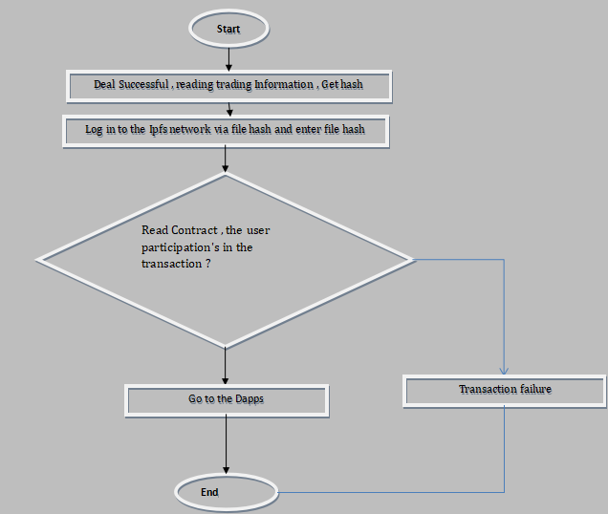
flowchart of Dinke-din

Slide 13
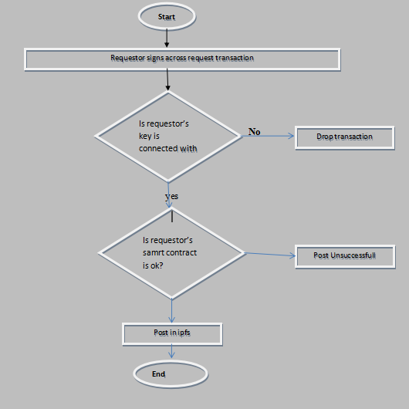
Flow Chart Diagram for User Posting

Slide 14
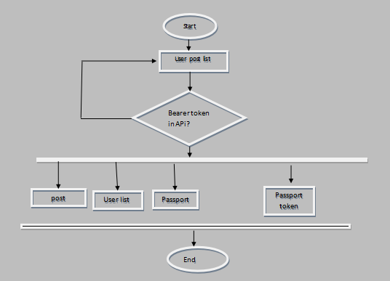
Flow Chart Diagram for Admin Panel

Slide 15
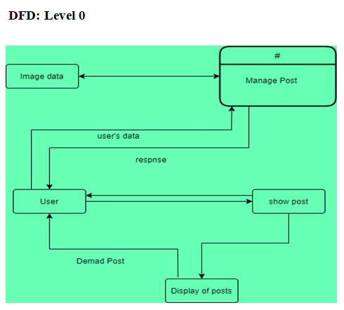
Data Flow Diagram of Security Module

Slide 16
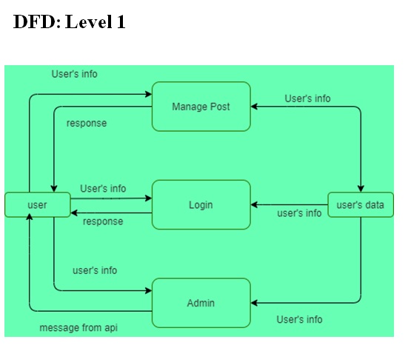
Data Flow Diagram of Security Module

Slide 17
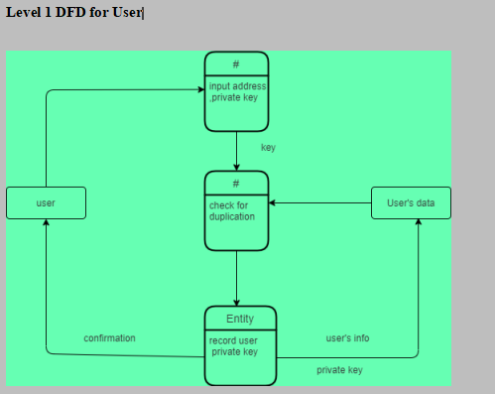
Data Flow Diagram of Security Module

Slide 18
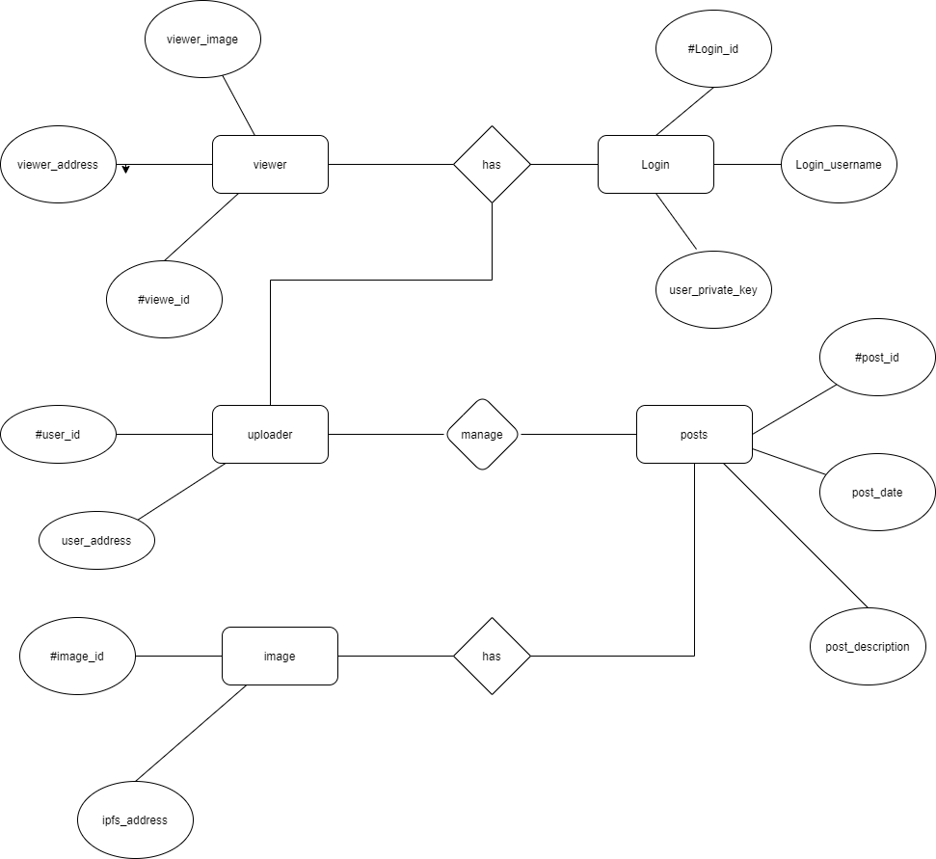
Entity Relationship Diagram

Slide 19
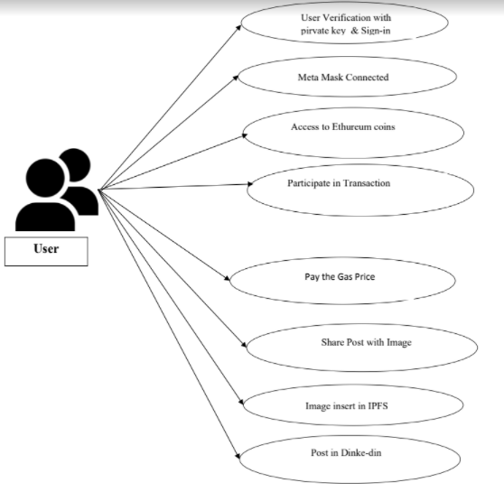
Use Case Diagram for dinke-din

Slide 20
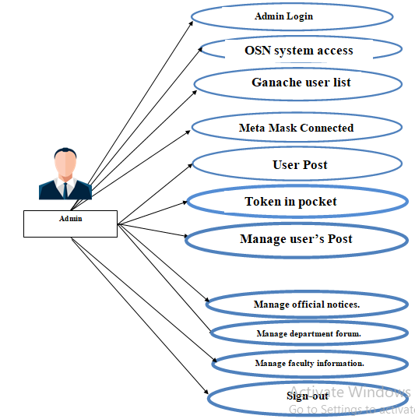
Use Case Diagram for Admin

Slide 21
Frontend tools

Slide 22
Backend tools

Slide 23
Testing results

Slide 24
Contribution

Slide 25
Limitation

Slide 26
Future work

Slide 27
References
[1] Pawade, Dipti, and Avani Sakhapara. "Blockchain Based Secure Traffic Police Assistant System." (2020).
[2] Sultana, Maliha, et al. "Towards developing a secure medical image sharing system based on zero trust principles and Blockchain technology." BMC Medical Informatics and Decision Making 20.1 (2020): 1-10.
[3] Adriano Witkowski and Altair Santin “An IdM and Key-Based Authentication Method for Providing Single Sign-On in IoT ”.
[4] R. Mehta, N. Kapoor, S. Sourav and R. Shorey, "Decentralised Image Sharing and Copyright Protection using Blockchain and Perceptual Hashes," 2019 11th International Conference on Communication Systems & Networks (COMSNETS), 2019, pp. 1-6, doi: 10.1109/COMSNETS.2019.8711440. Jabarulla, Mohamed Y., and Heung-No Lee. 2021. "Blockchain-Based Distributed Patient-Centric Image Management System" Applied Sciences 11, no. 1: 196. https://doi.org/10.3390/app11010196

Slide 28
[6]Kumar, Randhir, et al. "A secured distributed detection system based on IPFS and Blockchain for industrial image and video data security." Journal of Parallel and Distributed Computing 152 (2021): 128-143.
[7]Zhang, Lei, Mingxing Luo, Jiangtao Li, Man Ho Au, Kim-Kwang Raymond Choo, Tong Chen, and Shengwei Tian. "Blockchain based secure data sharing system for Internet of vehicles: A position paper." Vehicular Communications 16 (2019): 85-93.
[8]Feixiang, Zhao, Liu Mingzhe, Wang Kun, and Zhang Hong. "Color image encryption via Hénon-zigzag map and chaotic restricted Boltzmann machine over Blockchain." Optics & Laser Technology 135 (2021): 106610.
[9]Wang, Xingyuan, Le Feng, and Hongyu Zhao. "Fast image encryption algorithm based on parallel computing system." Information Sciences 486 (2019): 340-358.
[10]Laiphrakpam, Dolendro Singh, and Manglem Singh Khumanthem. "Medical image encryption based on improved ElGamal encryption technique." Optik 147 (2017): 88-102.

Slide 29
[11]Cai, Lu-Zhong, Ming-Zhao He, Qing Liu, and Xiu-Lun Yang. "Digital image encryption and watermarking by phase-shifting interferometry." Applied optics 43, no. 15 (2004): 3078-3084.
[12]Zhou, Yuezhi, Yaoxue Zhang, and Yinglian Xie. "Virtual disk based centralized management for enterprise networks." In Proceedings of the 2006 SIGCOMM workshop on Internet network management, pp. 23-28. 2006.
[13]Mohsin, A. H., A. A. Zaidan, B. B. Zaidan, K. I. Mohammed, Osamah Shihab Albahri, Ahmed Shihab Albahri, and M. A. Alsalem. "PSO–Blockchain-based image steganography: towards a new method to secure updating and sharing COVID-19 data in decentralised hospitals intelligence architecture." Multimedia tools and applications 80, no. 9 (2021): 14137-14161.
[14]Bhowmik, D., Natu, A., Ishikawa, T., Feng, T., & Abhayaratne, C. (2018, July). The Jpeg-Blockchain framework for glam services. In 2018 IEEE International Conference on Multimedia & Expo Workshops (ICMEW) (pp. 1-6). IEEE.

Slide 30
[16] Swapnil Ninawe and Pallapa Venkataram “Authentication schemes for social network users: a review ”.
[17]What is Blockchain ? what is the future of it 8 Reasons Why Blockchain Technology Is the Future | upGrad blog
[18] Zheng, Qiuhong, Yi Li, Ping Chen, and Xinghua Dong. "An innovative IPFS-based storage model for blockchain." In 2018 IEEE/WIC/ACM International Conference on Web Intelligence (WI), pp. 704-708. IEEE, 2018.
[19]Kozlowska, Iga. "Facebook and data privacy in the age of Cambridge Analytica." Seattle, WA: The University of Washington. Retrieved August 1 (2018): 2019.
[20]What is testing What is software testing? - Quora

